Slide 1

Catchment Partnerships
Essex Wildlife Trust/Essex Biodiversity Project have been successful in winning Catchment Partnership Fund support to develop the
Combined Essex catchment (£11.8k)
and with Thames Chase Trust leading the
South Essex catchment (11.8k)
and we anticipate involvement in other catchment groups ie Roding/Beam/Ingrebourne as they emerge

Slide 2
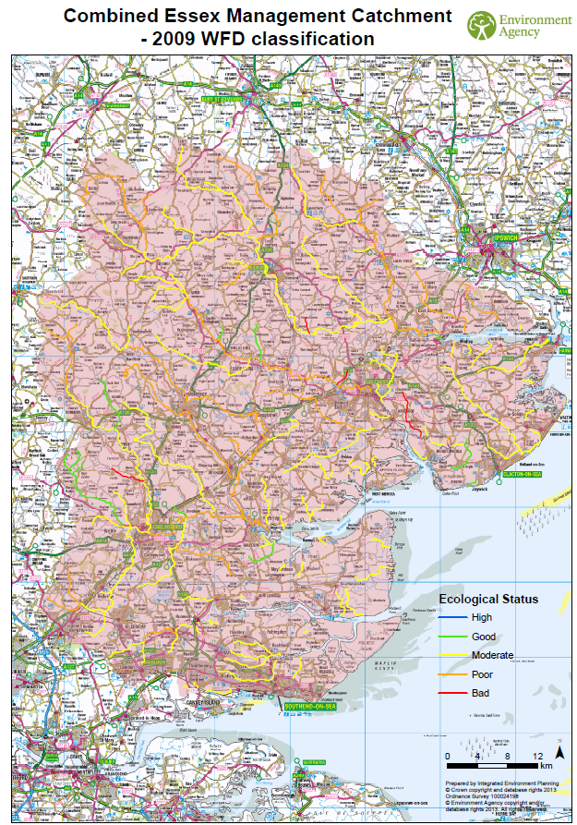

Slide 3
The Catchment Based Approach (CaBA)
Involving people at a 'catchment' level is often the most effective way of working together. A catchment is an area with several, often interconnected bodies of water, such as rivers, lakes, groundwater or coastal waters.
By working together across catchments the aim is to:
Understand the issues in the catchment and how they interact.
Understand how the issues are affecting the current local benefits and future uses of water.
Involve local people, communities, organisations and businesses in making decisions by sharing evidence.
Work out what issues to tackle as a priority.
Build towards a ‘catchment plan’, a simple statement of options to protect and improve the catchment which will feed into the River Basin Management Plan by March 2015

Slide 4
Essex Rivers Hub
Chelmer & Blackwater Partnership (EA, Natural England, Essex & Suffolk Water) | Teresa Meadows Chelmer and Blackwater Catchment Advisor Member of E&SW staff
Chelmsford Biodiversity Forum | Steve Plumb (Chair)
Dedham Vale AONB and Stour Valley Project | Katherine Potts
Environment Agency | Trev Bond (Geomorphologist)
 | Matt Butcher (Catchment Delivery Manager, Essex)
Essex & Suffolk Rivers Trust | Archie Ruggles Brice (Chair E&SRT)
Essex County Council | Kate Sheppard (Flood Partnerships Manager)
Anglian Water | Lucinda Guilfoyle
Essex & Suffolk Water | William Robinson (Water Resources Planning Manager)
National Farmers Union | Rob Wise (Environment Advisor)
Essex Waterways Ltd | Roy Chandler (Chair of Essex Waterways Ltd.)
Essex Wildlife Trust | Mark Iley (Biodiversity Co-ordinator)
 | Andy May (Conservation Manager)
 | Deb Howard (Conservation Assistant) note taking
Farming and Wildlife Group | Rebecca Inman

Slide 5
Essex Rivers Hub (ERH)
Co-ordinate what we do and spot gaps – gap analysis.
Influencing role – for example,
  getting the catchment Plan adopted into the main planning process;
  input to national policy such as agri-environment scheme review
Access to funding – obtain funding as a Partnership which it would be hard to obtain as individual organisations
Gather evidence that the Partnership is doing works
Pilot ideas and innovation
Take a role in delivering projects, either doing it or enabling others
Act as a resource for people who want to take action by providing expertise, support, bringing people together etc.
Data – data produced by partners to be shared with EA so that it can be added in or used to correct existing data.

Slide 6
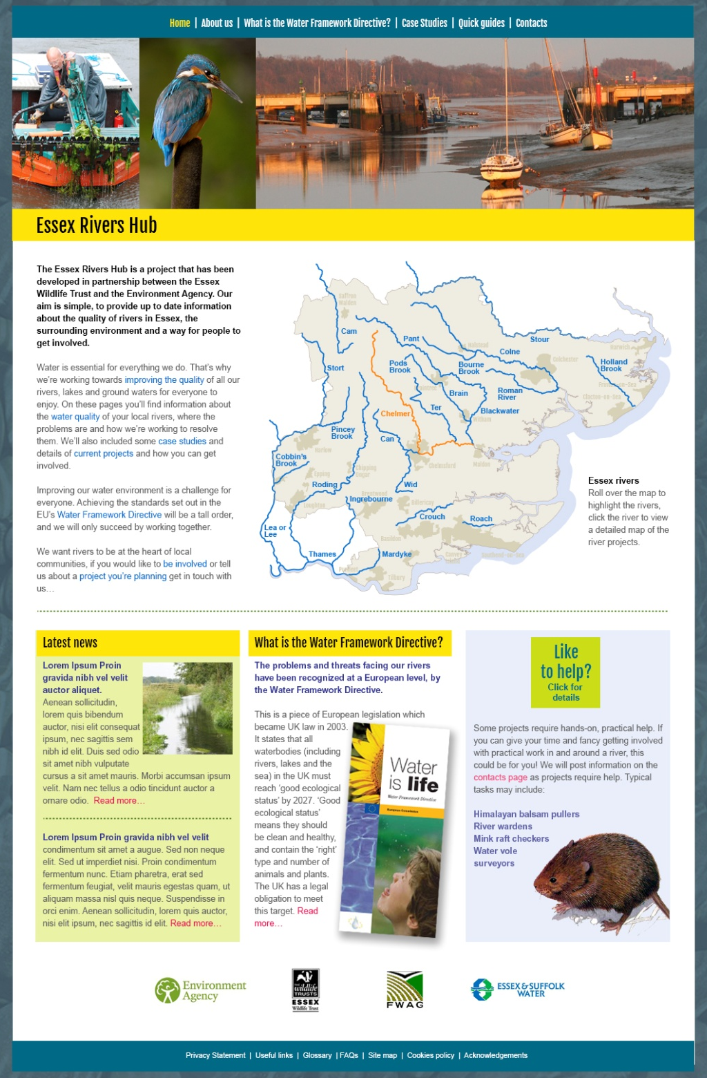
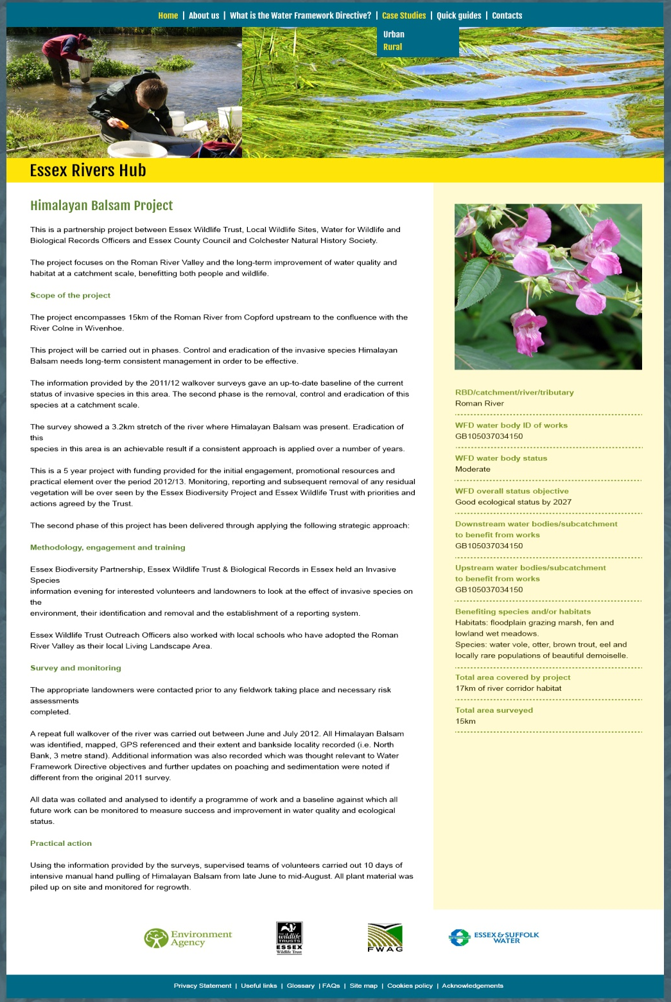
http://essexrivershub.org.uk/

Slide 7
Essex Rivers Hub
Plan and deliver two Essex Rivers Hub workshops - rural & urban (Sept/Nov 2014)
Report on progress Apr 2014 and make application to roll money into next financial year and draw down 2014 -15 funding (expected to be circa £12k)
E&SRT agreed to deliver 12 days paid support
Take on paid student placement (12hrs per week x 24 weeks)
Avoid just becoming a talking shop…

